Slide 1



DEPARTMENT OF ELECTRONICS AND COMMUNICATIONENGINEERING
18ECP104L-MINOR PROJECT-II
FINAL REVIEW
BLUETOOTH CONTROLLED DATA LOGGER ROBOT FOR SOIL TESTING
BATCH NO: 34
DATE:25.04.2023
GUIDED BY:
Dr.E.DINESH
Associate Professor,ECE
PRESENTED BY:
MUTHULAKSHMI M -927621BEC130
MONISHA A - 927621BEC129
NANDHINI G - 927621BEC131
NAVANEETHA S - 927621BEC134

Slide 2
INTRODUCTION
Bluetooth controlled Robot car is controlled by using Android mobile phone ,the same robot car can also be used to control via gesture, obstacle and rf etc.
An application has to be downloaded from play store to control the car in forward, backward, left and right directions.
This robot can be controlled with a smartphone using Bluetooth through an Android app.
Its three sensors can measure four parameters: temperature, humidity, soil moisture, and ambient light intensity in greenhouses, farms, gardens, parks, etc.
Usually robots like robotic hand, agriculture robot, fire-fighting robot, spy robot etc…. Remote-controlled robots are mostly wireless.

Slide 3
ABSTRACT
A Bluetooth controlled data logger robot for soil testing would be a robot equipped with sensors to measure various soil properties such as moisture, temperature, and pH.
The robot would use Bluetooth technology to communicate with a nearby device, such as a smartphone or computer, to collect and store data.
The robot could then transmit this data to the device for analysis, allowing for efficient and accurate monitoring of soil conditions. This type of robot could be useful for agriculture, environmental research, and other applications where monitoring soil conditions is important. This project provides an solution for testing of soil.
Keywords— Arduino UNO, Soil moisture sensor, Temperature and Humidity sensor.

Slide 4
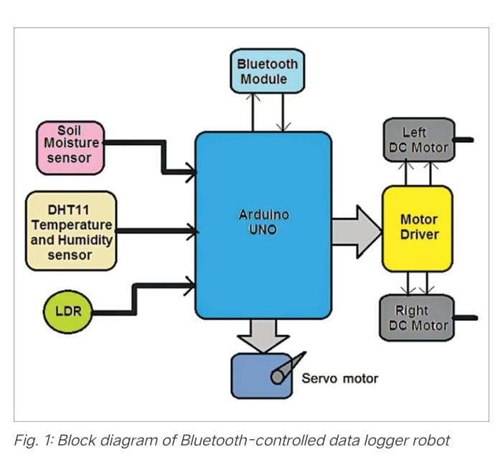
BLOCK DIAGRAM

Slide 5
WORKING
The major building blocks of the system include the three sensors (soil moisture, DHT11 temperature and humidity sensor, and LDR), an Arduino Uno development board, Bluetooth module HC-05, DC servo motor, two DC gear motors, and motor driver chip L293D.
Soil moisture sensor (SM1) is used to measure moisture content in soil and give analogue voltage output as per the moisture level. Its output voltage decreases as moisture content increases.
DHT11 temperature and humidity sensor (SM2) is a smart sensor that measures atmospheric temperature and humidity and gives direct digital values for temperature in °C and for humidity in % RH.The light dependant resistor (LDR1) is a photo-conductive device whose resistance decreases as light intensity increases, and vice versa..

Slide 6
WORKING
Bluetooth module (HC-05) is used to command (to move forward, reverse, left, and right) the robot from a smartphone with the help of Arduino Uno microcontroller.
Motor driver L293D (IC1) provides sufficient voltage and current to both the motors to rotate them. It amplifies the output of Arduino board (Board1) and drives the motors.The DC motors (M1 and M2) drive left and right wheels of the robot and move it forward, backward, left, and right.
Soil moisture sensor (SM1) is attached to servo motor (M3) shaft. This motor moves the sensor up and down to insert it into the soil to check soil moisture content.
HC-05 module operates on 5V received from the Arduino board. It communicates with Arduino board with USART pins Tx (D1) – Rx (D0). So, its Tx pin is connected to Rx pin of Arduino board and vice versa.
DHT11 sensor also gets its 5V supply from Arduino board. Its digital output is connected to digital pin D7 of Arduino.

Slide 7
WORKING
The analogue output of soil moisture sensor (SM1) is connected to analogue input pin A1 of Arduino board. Its 5V supply also comes from Arduino board.
Digital pins D8, D9, D10, D11 of Arduino board drive DC motors M1 and M2 using L293D chip. These pins are connected to inputs of L293D, and two motors are connected to output of the chip. Servo motor signal (sig) input is connected to PWM output pin D6 of Arduino board. The motor gets 5V supply from Arduino board.
The motor supply pin Vss of L293D (pin 8) gets 12V from battery. The Arduino board also gets 12V input at its Vin pin from battery. That is, Vin pin gets 12V input and gives 5V output to all other components.

Slide 8
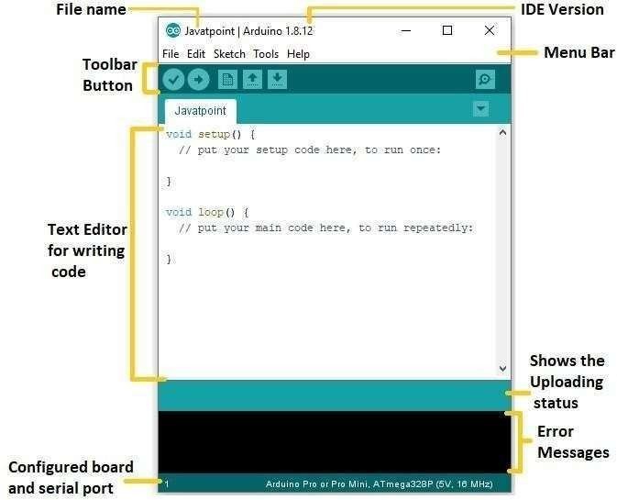
SOFTWARE
The program code (BT_controlled_robot.ino) is written in Arduino programming language. It was tested using Arduino IDE version 1.8.18.
Before compiling and uploading the code, make sure you include the relevant libraries, such as DHT_sensor_library-1.4.2 and DHT sensor library version 1.4.3.
During testing it was found that without these libraries the code could not be compiled.

Slide 9
SOFTWARE
Arduino IDE is an application that is used to write codes and uploads them to the Node MCU board.
In this project, Arduino IDE is used for coding, debugging, and testing the functionalities of the IOT smart Home Automation system and its components.
Arduino IDE has other features, such as a debugging area in case of abnormal conditions to support various Arduino boards, additional libraries, and a serial monitor for communicating with the board.
Arduino libraries are usually expressed as dot CPP files based on software abstraction called wiring Arduino uses the bits of C and C++,but the general flow and structure of the code are heavily based around C

Slide 10
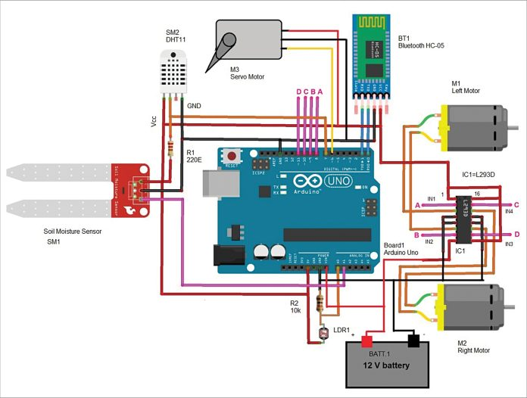
CIRCUIT DIAGRAM

Slide 11
CIRCUIT AND OPERATION
The circuit operation starts when 12V battery is connected to Arduino Uno board and L293D chip.
Initially, both motors (M1 and M2) are at rest and so the robot is also at rest.
The servo motor (M3) is at 0° position and soil moisture sensor is in upward position.To move the robot in any direction, command is required from smartphone through Bluetooth based Android application, called Bluetooth Terminal HC-05

Slide 12
CIRCUIT AND OPERATION
Now you can send commands from the smartphone to robot to move using the app.
Following commands given in the table are used to move the robot (all these commands are already set in Android application):
When any of the above commands is sent (by sending the character in capital letter), it is received by HC-05 module.
The module further gives this command to Arduino serially through its Tx-Rx pins. Arduino gets this command and compares it with set commands. If they match, the robot moves in the desired direction.

Slide 13
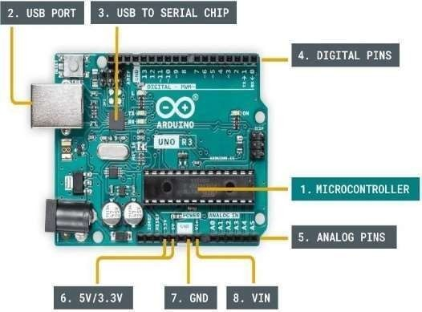
ARDUINO UNO
The Arduino Uno is an open-source microcontroller board based on the Microchip ATmega328P microcontroller and developed by Arduino.cc and initially released in 2010.
The board is equipped with sets of digital and analog input/output (I/O) pins that may be interfaced to various expansion boards (shields) and other circuits. The board has 14 digital I/O pins (six capable of PWM output), 6 analog I/O pins, and is programmable with the Arduino IDE (Integrated Development Environment), via a type B USB cable.
It can be powered by the USB cable or by an external 9-volt battery, though it accepts voltages between 7 and 20 volts.

Slide 14
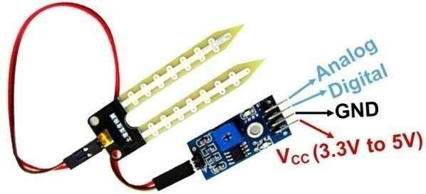
SOIL MOISTURE SENSOR
Soil moisture sensors measure or estimate the amount of water in the soil.
These sensors can be stationary or portables such as handheld probes. Stationary sensors are placed at the predetermined locations and depths in the field, whereas portable soil moisture probes can measure soil moisture at several locations.
The SM1 soil moisture probe is an extremely flexible system, offering capacitance based measurement of soil moisture plus temperature monitoring.

Slide 15
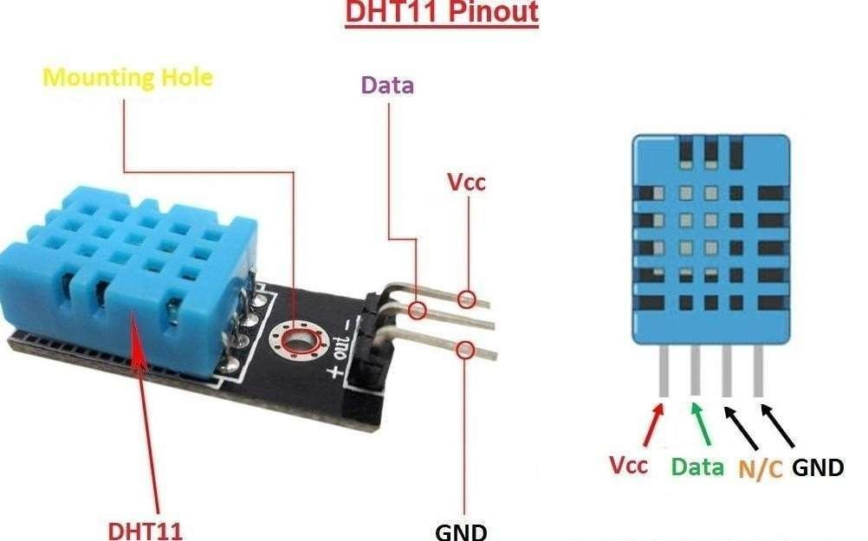
DHT11 SENSOR
DHT11 sensor also gets its 5V supply from Arduino board. Its digital output is connected to digital pin D7 of Arduino.
The analogue output of soil moisture sensor (SM1) is connected to analogue input pin A1 of Arduino board. Its 5V supply also comes from Arduino board.
LDR1 is configured in pulled-down mode with 10-kilo-ohm pull-down resistor. Its analogue output is given to analogue input pin A0 of Arduino board.

Slide 16
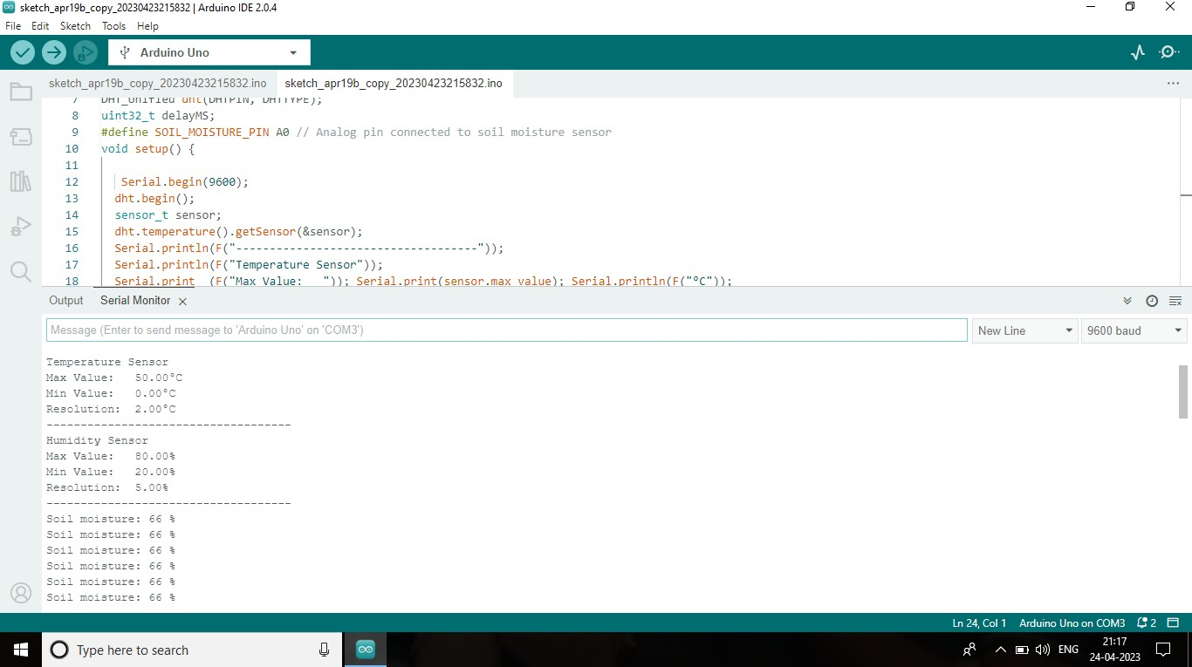
RESULT

Slide 17
REFERENCE
https://www.robotics.org/blogarticle.cfm/Robotics-in-Agriculture-Types-and Applications/74.
ieeexplore.ieee.org/document/6139624.
https://www.researchgate.net/publication/254048454_Agribot A_multipurpos e_agricultural_robot.
Agriculture Robotics in Japan Nobutaka Ito ProfessorDept.OfBioproduction and Machinery Mie University, Japan, IEEE International Workshop on Intelligent Robots and Systems IROS '90
Amrita Sneha.A,, ―AgriculturalRobotforAutomatic Ploughing and Seeding,‖ 2015 IEEE International Conference on Technological Innovations in ICT for Agriculture and Rural Development (TIAR 2015)
Timo Blender, ―Managing a Mobile Agricultural Robot Swarm for a Seeding Task,‖ 978-1-5090- 3474-1/16/$31.00 ©2016 IEEE

Slide 18


